Slide 1
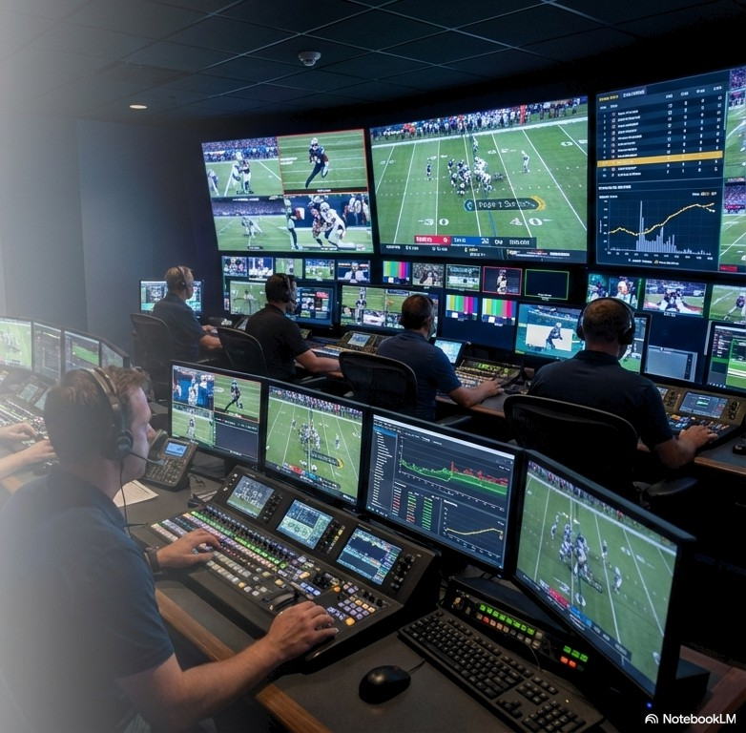
AI and the Future
of the U.S.
Professional
Sports Sector
A Story of Augmentation, Not Automation
Chloe Norwood
RESECON 490AI: AI in Economics
December 2025

Slide 2
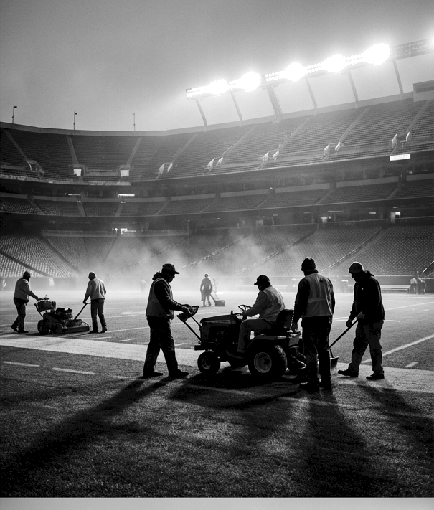
Personal Motivation
Preparing for a long-term career in athletics operations and events.
AI is rapidly reshaping workflows I’ll use daily (video, logistics, planning).
My previous experience in athletics made me curious about AI’s impact firsthand.

Slide 3




The U.S. Pro Sports Sector =
Mature, $83 Billion Powerhouse.
$83B+
Annual Revenue
4 Dominant Leagues
NFL, NBA, MLB, and NHL
~224,000
Employees in the spectator sports workforce

Slide 4
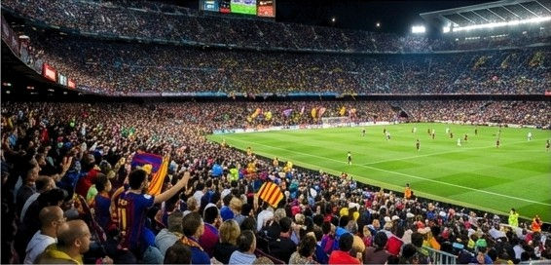

Structurally Stable Industry
With AI Remodel
High barriers to entry + stable employment patterns = mature industry
AI-Driven systems used for video analysis, dynamic pricing, fan engagement, and more.

Slide 5

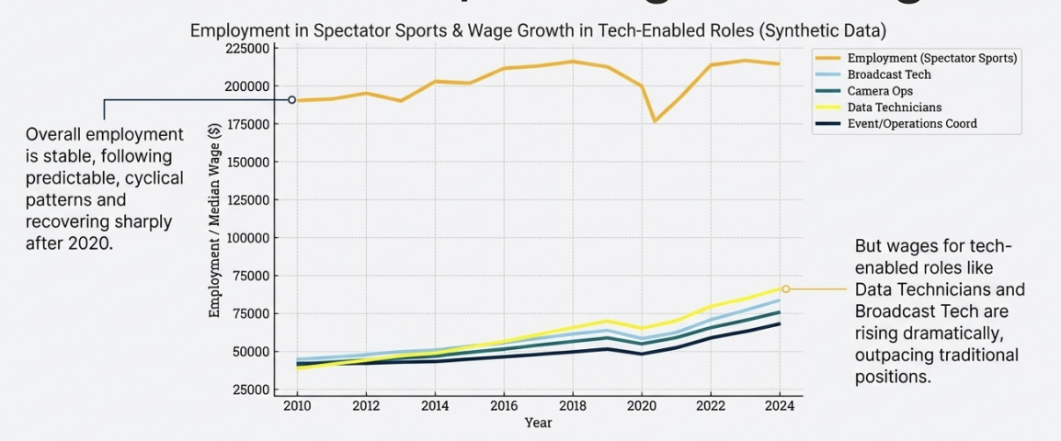
The Data Shows a Clear Divergence:
Stable Headcount, Soaring Tech Wages

Slide 6
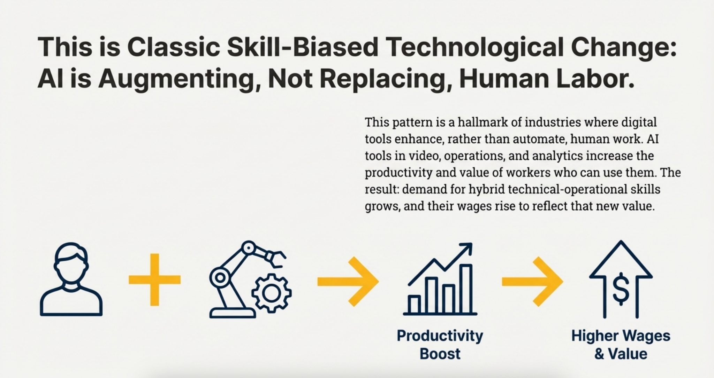

Slide 7


Organizations are Shifting Investment from Headcount to Productivity-Enhancing AI.
Player & Team Performance
Automated video breakdowns and real-time analytics dashboards for scouting and strategy.
Business Operations
Dynamic ticket pricing models, predictive marketing systems, and automated scheduling.
Fan Experience
Personalized content delivery, Al-driven scoring models, and biometric stadium entry.
G NotebookLM

Slide 8
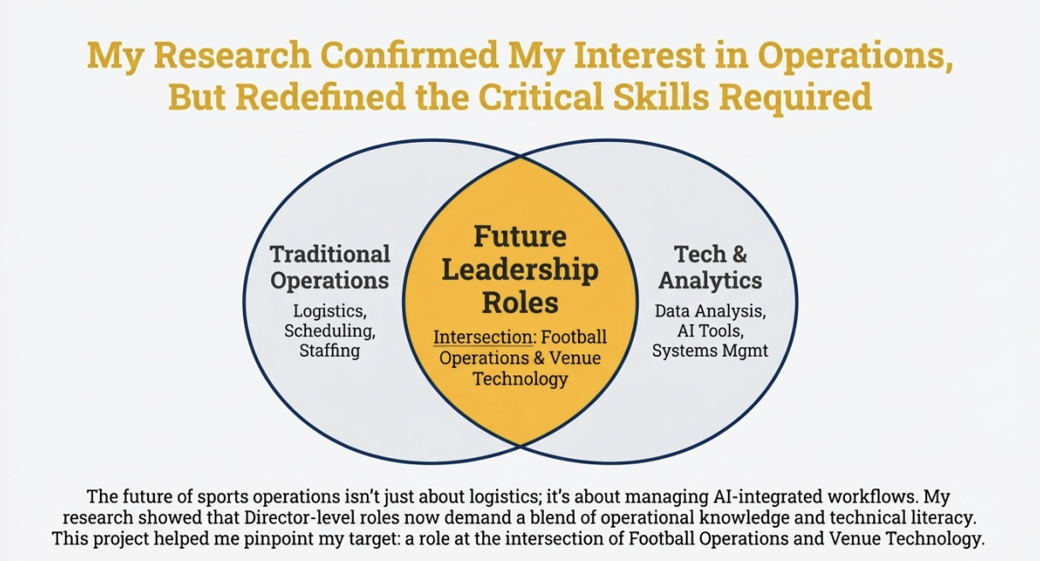

Slide 9

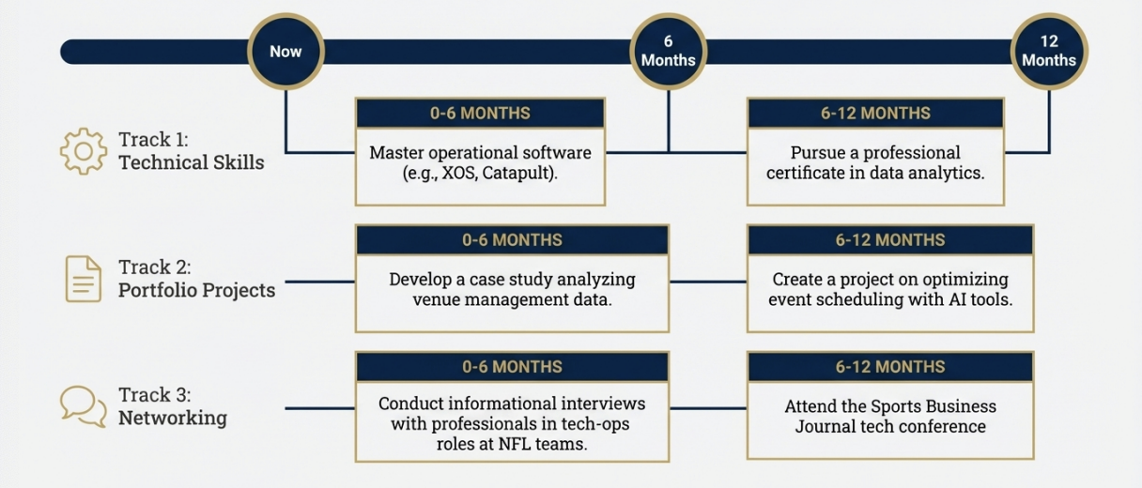
My 12-Month Action Plan

Slide 10
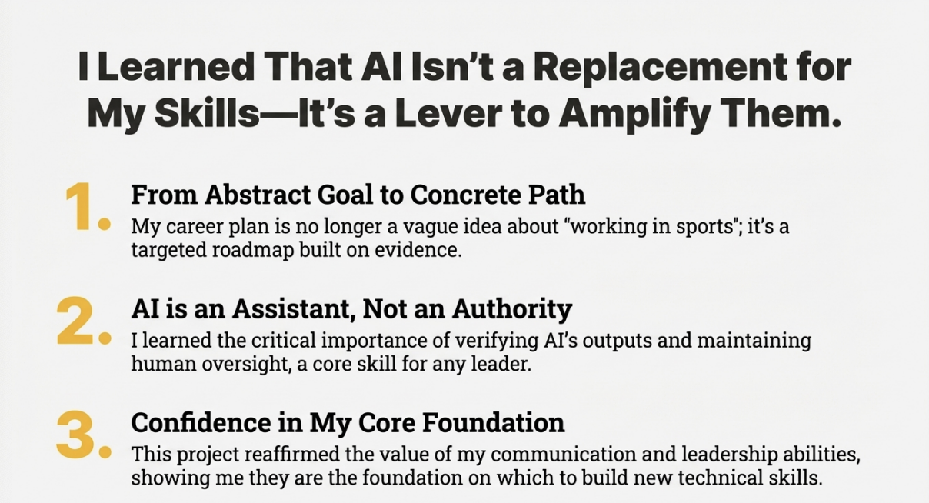

Slide 11
